Slide 1

Fish-Ai
Ai based integrated farm

Slide 2
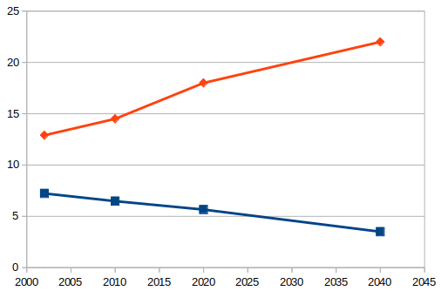
Problem Statement
Population in Bangladesh is increasing but the agricultural production is decreasing. The production of food can not keep pace with our increasing people.
Cultivatable Land (m.ha)
Population(Crore)
Figure: Population and Land in Bangladesh

Slide 3
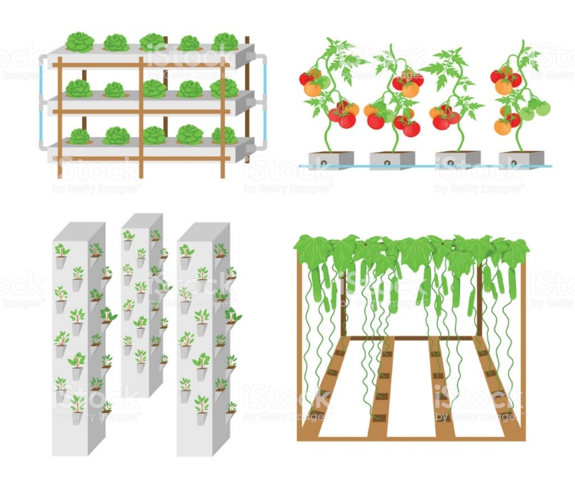
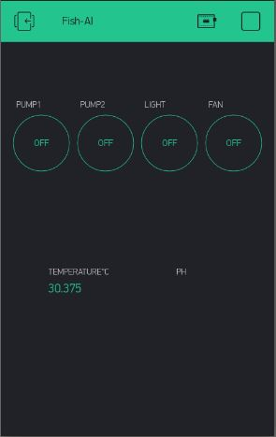
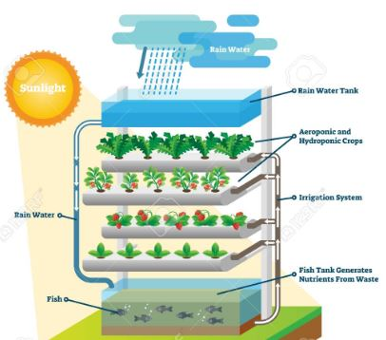

Solution

Slide 4
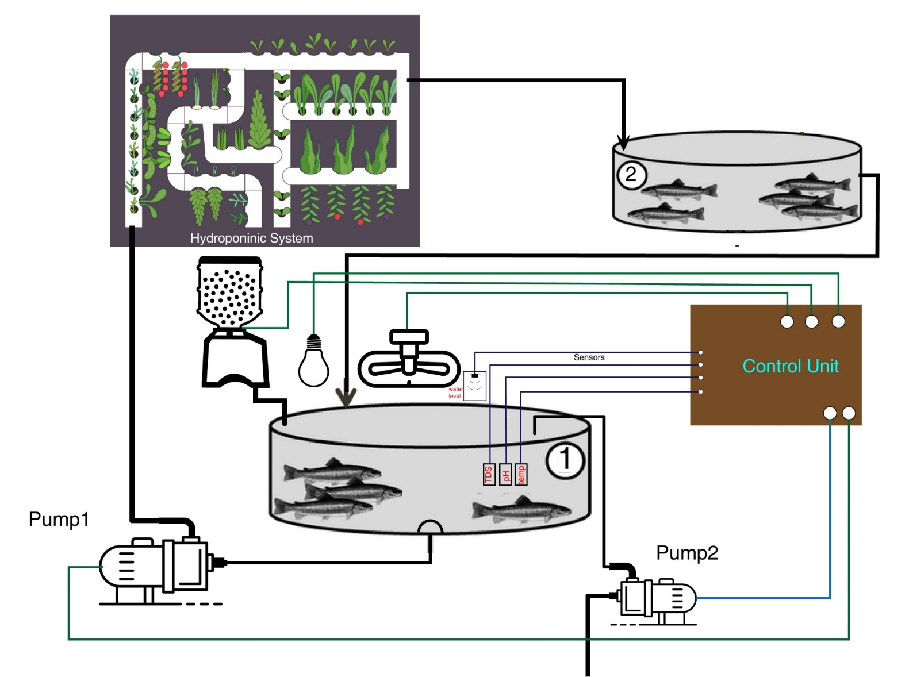
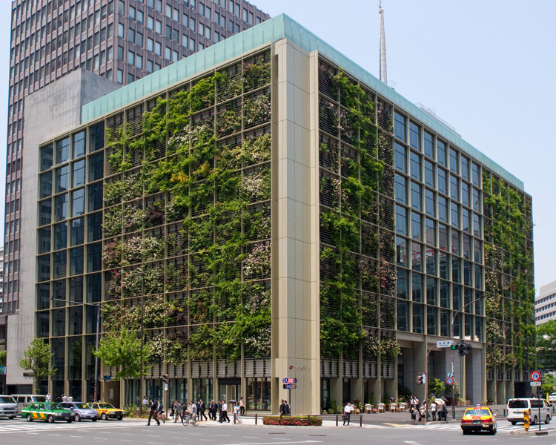
Figure: Overall System

Slide 5
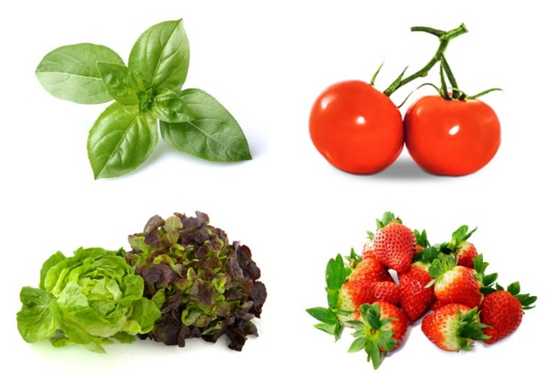
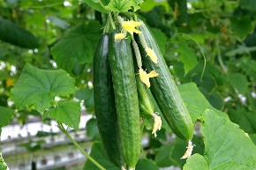
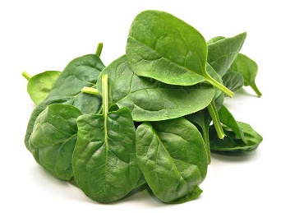
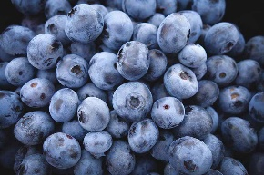

Beneficial Scenario
Fresh Food (Fish, Vegetables)
Environmental impact
Social impact
Family Business
Leisure
Entertainment
Breathing Space
Hobby

Slide 6
Market Size
Primary Location of operation: Dhaka City
300 thousand buildings in Dhaka city.
Competitive Advantage: We use Artificial Intelligence

Slide 7
Sales and Market Strategy
Blog
Post on social media
Sponsor an event
Company Website
Referrals

Slide 8
Thank you

